Slide 1

AI, ML and Business Strategies
By
Arun Panayappan

Slide 2
Agenda
Introduction to Machine Learning
Supervised Learning – Classification and Regression
Unsupervised Learning – Clustering
Deep Learning using neural networks
Machine Learning use cases – Text, Vision and Speech

Slide 3
Introduction to Machine Learning and Artificial Intelligence

Slide 4
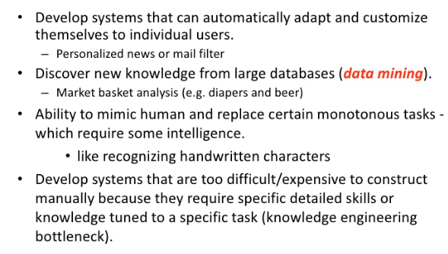
Why Machine Learning

Slide 5
Why Now?
Flood of data available (especially with the advent of the internet)
Increasing computation power
Growing progress in available algorithms and theory developed by researchers
Increasing support from industries

Slide 6
Some Sample Applications
Amazon product recommendations
Siri, Google Now
Text to speech, translations
Image recognition
Chatbots

Slide 7
Sample Use Cases - CRM
Fundamentally CRM is a database of customers, products that needs astronomical time to put data in
Automatically identify the leads, customer segments
Automatically record and analyze customer conversations and make recommendations for sales scripts
Automatically collect all data about the customer and organize them
Identify similar customers so we can sell this product
Identify the sales representative for a customer

Slide 8
Sample Use Cases - ERP
Conversational user interfaces that use historic data to fill forms
Automatically read and process invoices
Automatically fill timesheets and process them
Fill and file my expense report
Build a data lake from heterogeneous data sources
Canonical usable data models with uniform format with preprocessing
Create enterprise documents using events related to data changes

Slide 9
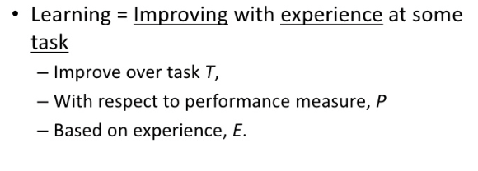
How Does A Machine Learn?

Slide 10
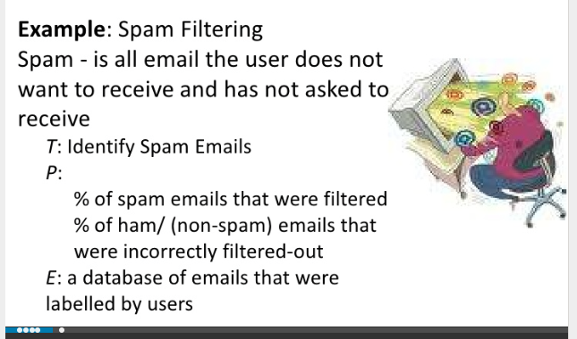
Simple Machine Learning Example

Slide 11
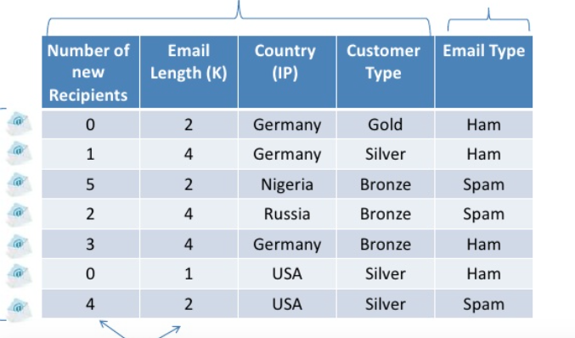
Preprocess Data

Slide 12
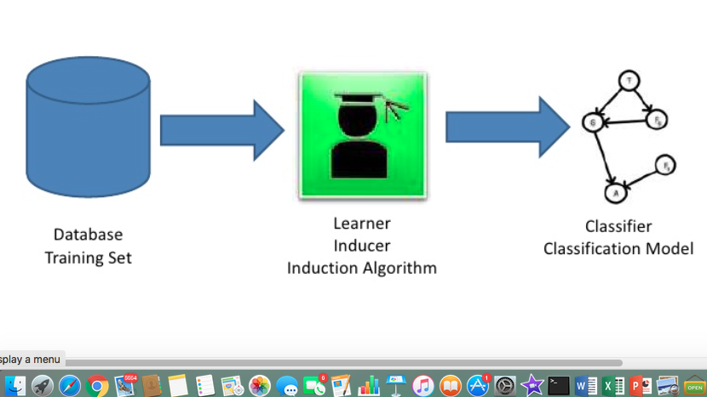
Learning Model Training

Slide 13
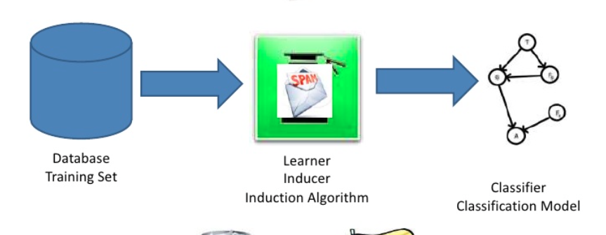
Test The Model

Slide 14
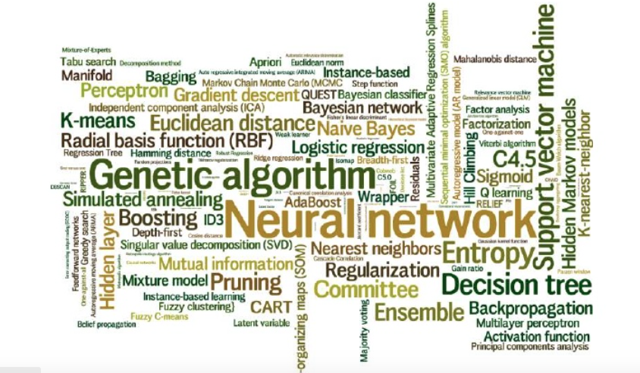
Learning Algorithms

Slide 15
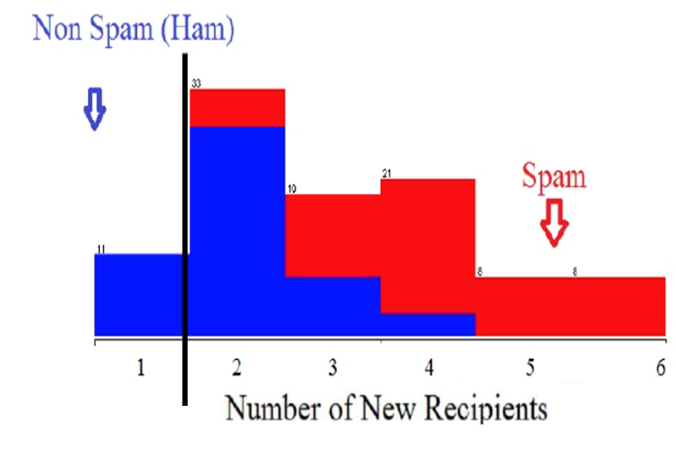
Spam Classifier

Slide 16
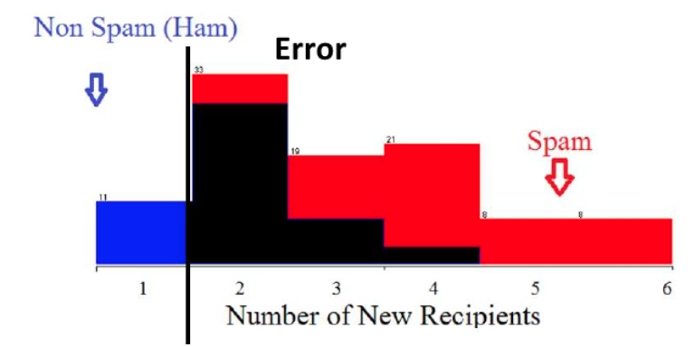
Spam Classifier

Slide 17
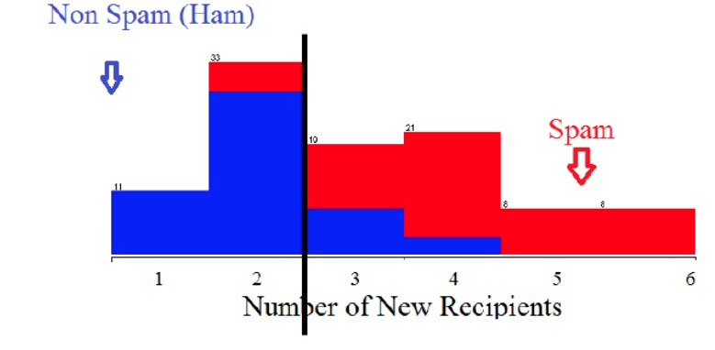
Spam Classifier

Slide 18
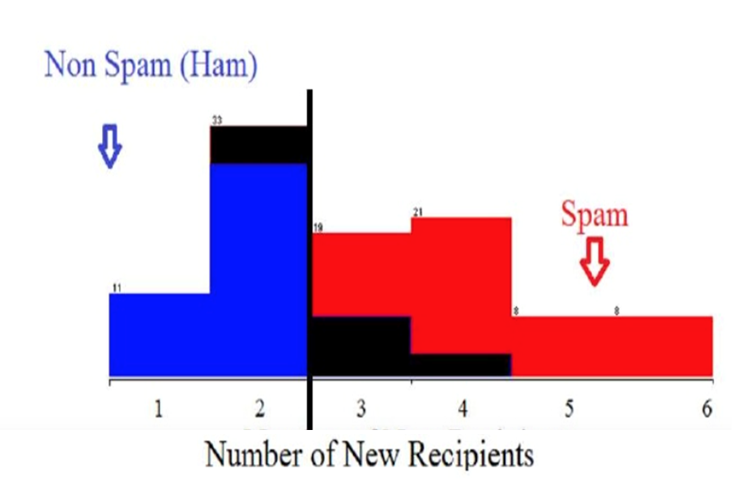
Spam Classifier

Slide 19
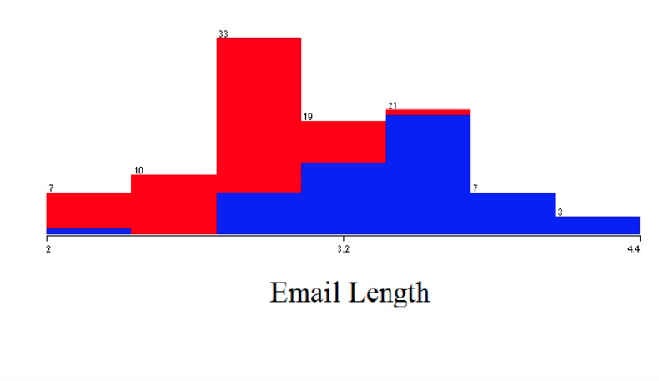
Spam Classifier

Slide 20
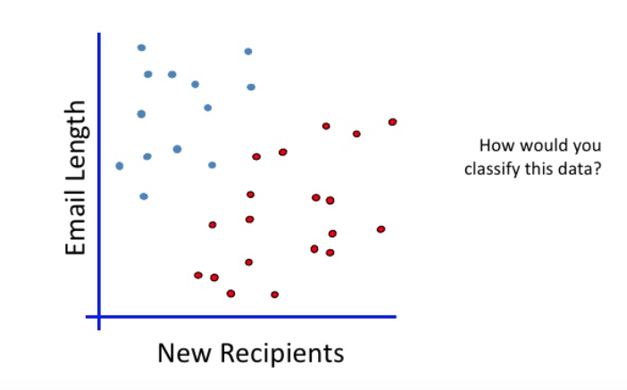
Linear Classifier

Slide 21
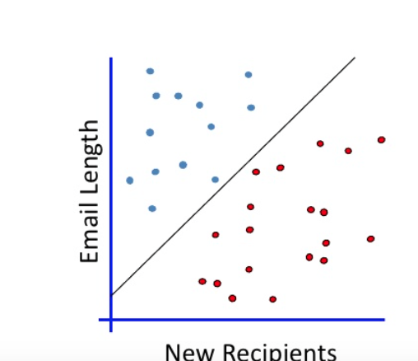

Best Fit Line

Slide 22
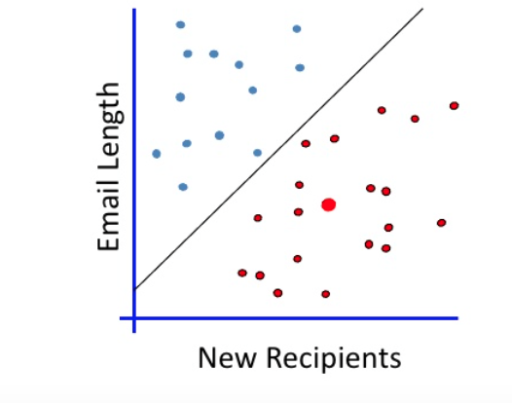
When A New Email Is Sent

Slide 23
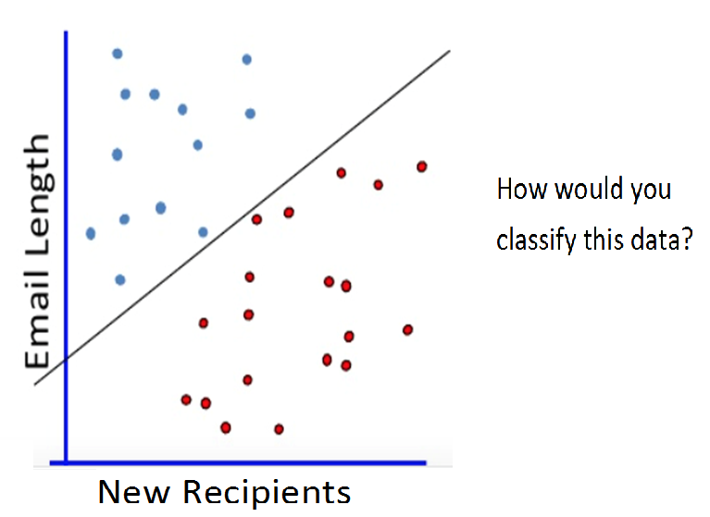
Which Is The Right Line?

Slide 24
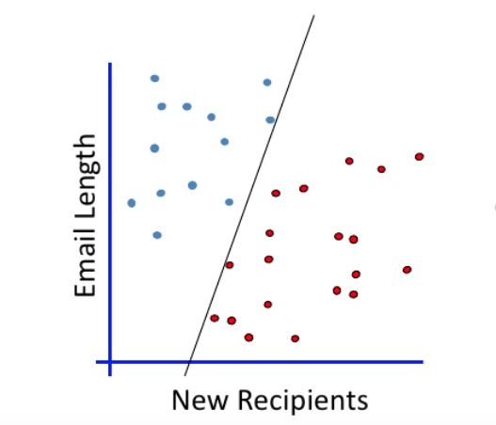
Which Is The Right Line?

Slide 25
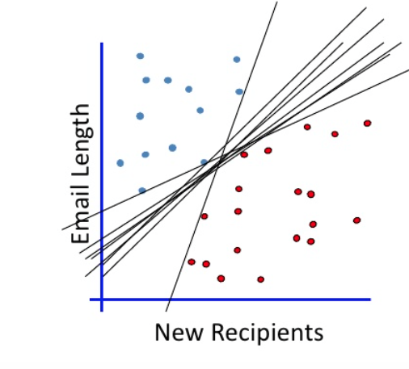
Which Is The Right Line?

Slide 26
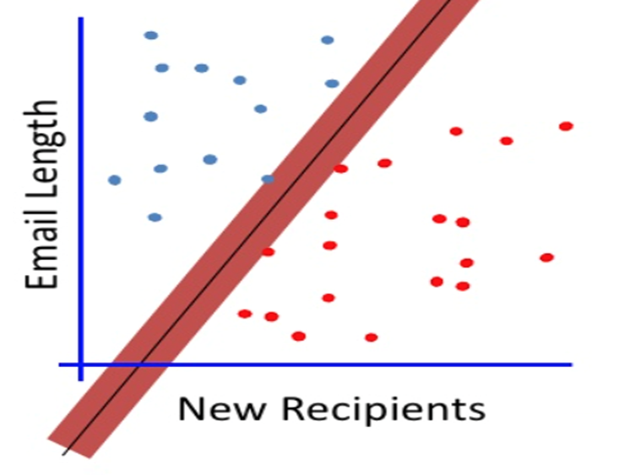
Maximum Margin

Slide 27
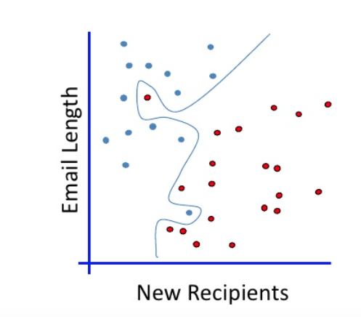
No Linear Classifier Fits This

Slide 28
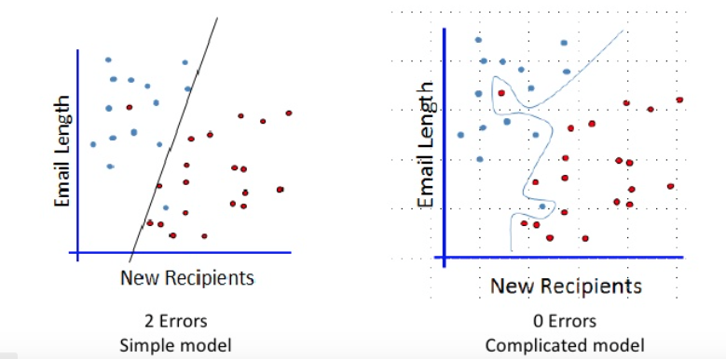
Which One?

Slide 29
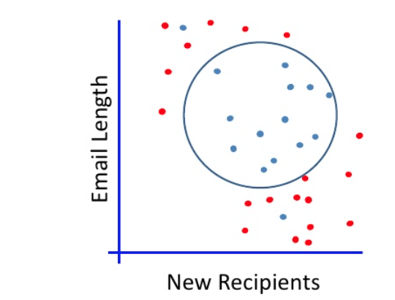
Non-Linear Separation

Slide 30
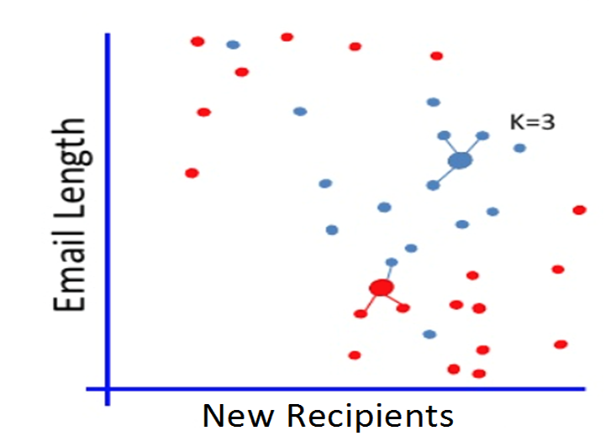
K-Nearest Neighbors

Slide 31
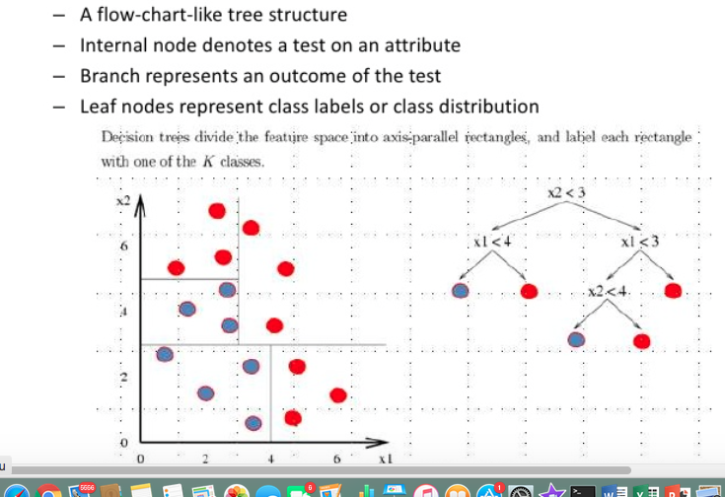
Decision Trees

Slide 32
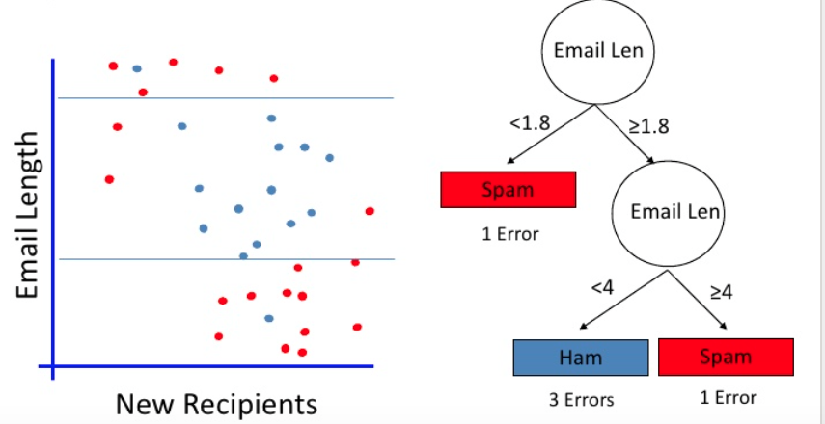
Sample Decision Tree

Slide 33
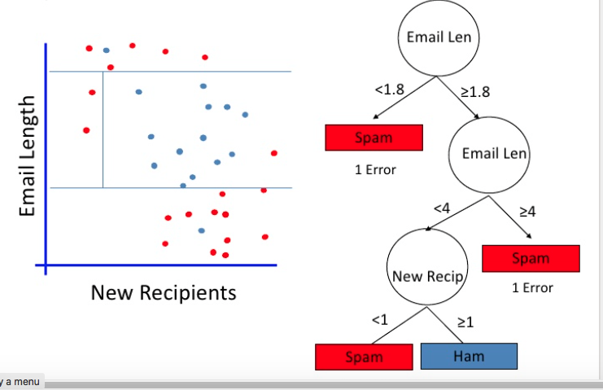
Decision Tree With Multiple Constraints

Slide 34
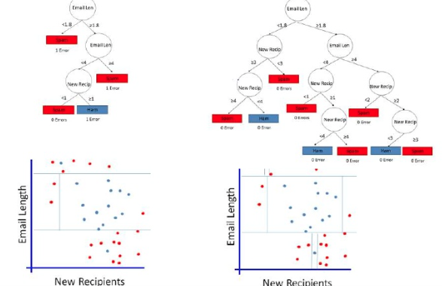
Which One?

Slide 35
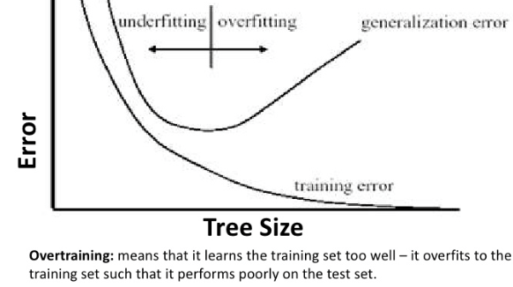
Overfitting And Under Fitting

Slide 36
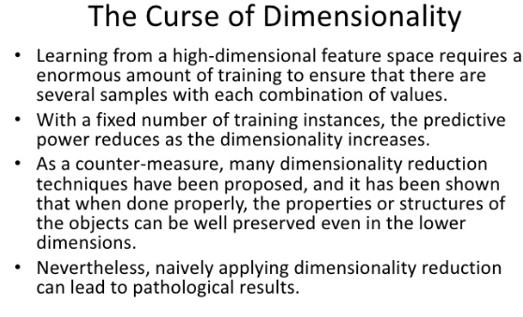
Less is More

Slide 37
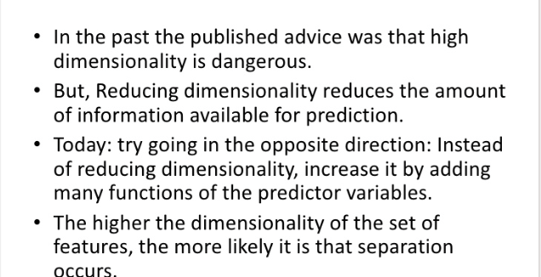
Less Is More – Not Any More

Slide 38
Introduction to Artificial Intelligence

Slide 39
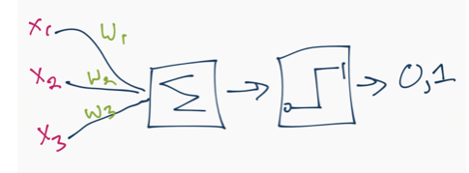
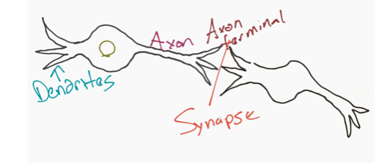
Neural Network Sample

Slide 40
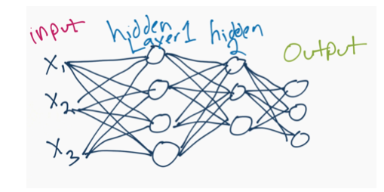
Neural Network Example

Slide 41
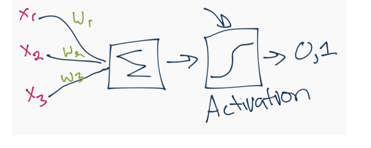
Simple Neural Network

Slide 42
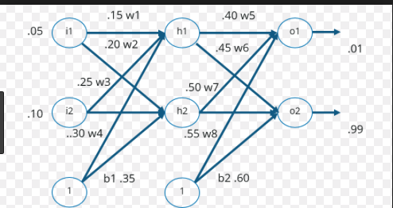
Back Propagation Learning

Slide 43
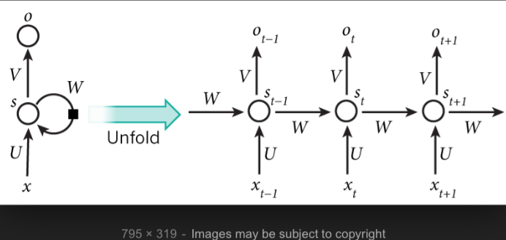
Recurrent Neural Networks

Slide 44
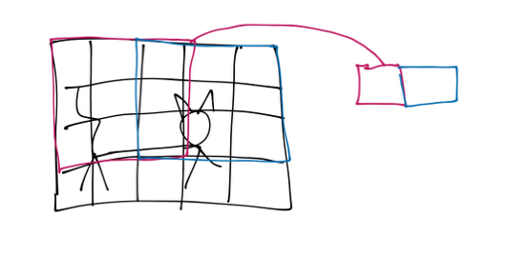
Convolution Neural Network

Slide 45
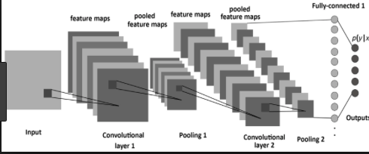
Convolutional Neural Networks

Slide 46
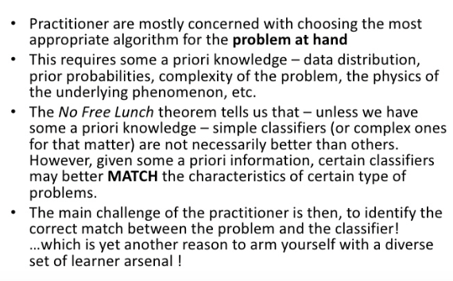
Why New Algorithms

Slide 47
Business Strategies to implement Artificial Intelligence

Slide 48
How Big is AI ?
It is a $1.45Billion industry today
It will be $8.8 billion industry by 2022

Slide 49
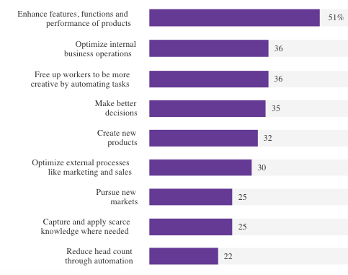
Business of AI – Harvard Business Survey

Slide 50
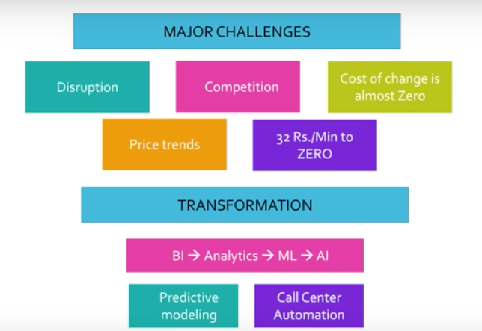
Telecom Landscape

Slide 51
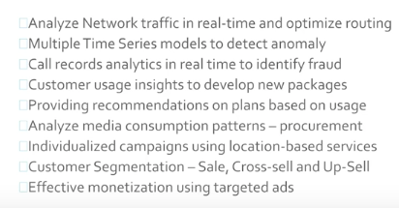
Telecom – AI Application

Slide 52
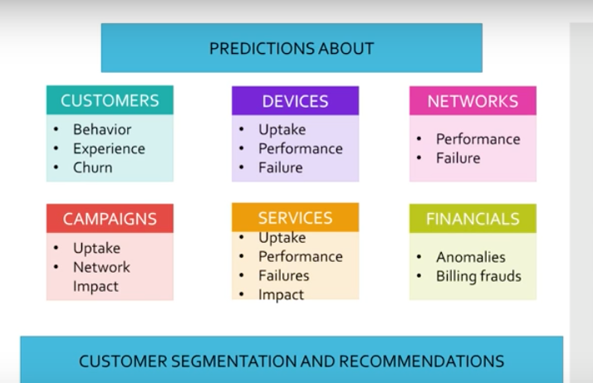
Telecom ML Opportunities

Slide 53
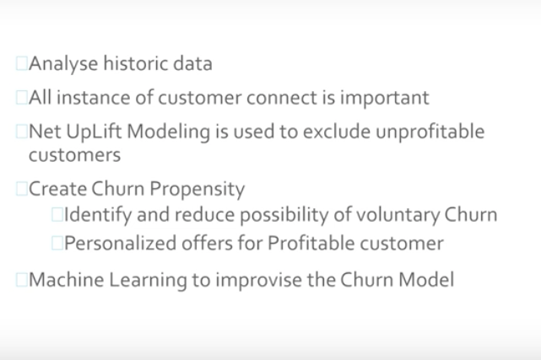
Customer Churn - Telcos

Slide 54
Customer Churn
https://datascienceplus.com/predict-customer-churn-logistic-regression-decision-tree-and-random-forest/

Slide 55
AI Strategy
Data and talent will be the differentiator
Think through the big picture and identify automation opportunities on mundane tasks
Trained rather than programmed – Need high volumes of data
Continuously collect metrics like accuracy and performance
Retrain the model as data changes

Slide 56
Top Marketing Trends (Salesforce 2017 survey)
Personalized Landing Pages
Programmatic advertising
Lead nurturing using social media
Use AI for customer segmentation
Increase click through rates for promotional messages

Slide 57
Sales Funnel
Identify buyer persona based on CRM data using semantic analysis
Route sales enquires to the right sales experts

Slide 58
Ad Placement and Fraud Detection
Behavior Analysis for Ad Placement
Identify shopping behavior from purchase history
Identify and analyze ads clicked by a cluster for content type, time of the day, device used and the channel used
Fraud Detection
Identify fraud transactions at the time of purchase using features

Slide 59
Customer Service
Chatbots can provide 26/7 support and collect data about the transactions
Chatbots can capture sentiments
Chatbots can seamlessly transfer control to human counterparts

Slide 60
Service Delivery and Accounting
Service Operations
Operation teams get a head start in customer relationship and context sharing from CRM
Predictive Maintenance of systems based on historic data
Accounting
Bots used for data entry
Data analytics will be used in accounting

Slide 61
Payroll, HT and Compliance
Payroll and HR
Small and medium size businesses can use automated approvals
Automatically submit forms for compliance(e.g. IRS)

Slide 62
Buy vs Build
Data scientists are expensive. They cost 160K on average as per glass door
Purchasable AI software and pay per use APIs can reduce costs
Is technology an enabler or a strategic differentiator?
Use of APIs can enable high growth businesses to role out products fast

Slide 63
People Angle
Buy in from every stakeholder is critical for the success of the strategy
Employees will fear jobs being taken over digital agents
Educate employees on what AI will and will not do for the business
Enable employees to see that AI frees up their bandwidth

Slide 64
Operations Planning
Plan to buy or develop an Artificial Intelligence platform for devops
Plan staffing required to manage AI operations

Slide 65
Python Numpy

Slide 66
Numpy – What is it?
A library to play with multi-dimensional arrays
It is Numerical Python
Numpy and Mathplotlib go hand in glove
This is a open source library

Slide 67
Installing ML Libraries Using Conda
https://www.davidculley.com/installing-python-on-a-mac/
https://conda.io/docs/user-guide/install/windows.html

Slide 68
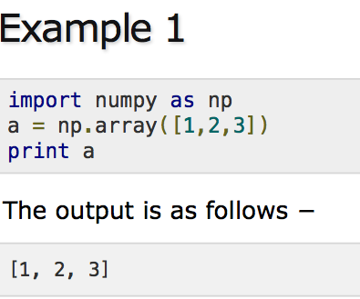
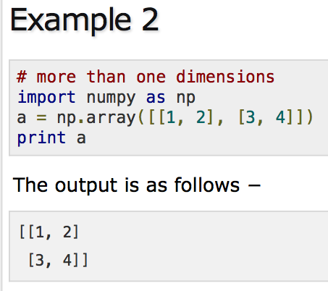
Numpy Examples

Slide 69
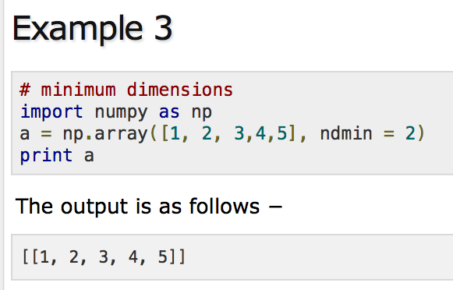
Numpy Examples

Slide 70
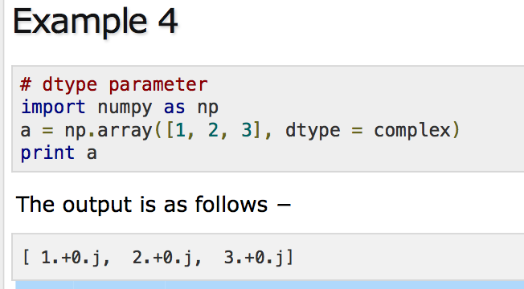
Numpy Examples

Slide 71
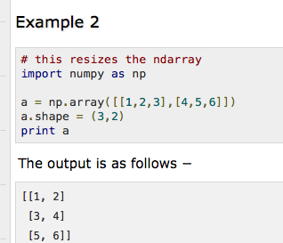
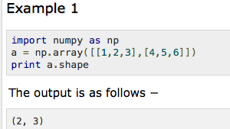
Numpy Arrays

Slide 72

Numpy Arrays And Examples

Slide 73

Numpy Arrays

Slide 74

Numpy Arrays With Multiple Dimensions

Slide 75
For More Examples On Numpy
https://www.tutorialspoint.com/numpy/numpy_array_from_existing_data.htm

Slide 76

https://github.com/arunpa0206/mltraining

Slide 77
Linear Regression

Slide 78


Sample Data

Slide 79


Sample Data

Slide 80


Linear Algebra

Slide 81

Squared Error

Slide 82

Coefficient Of Determination

Slide 83

Low Variance And Positive Correlation

Slide 84

Low Variance And Negative Correlation

Slide 85
K – Nearest Neighbors

Slide 86

Sample Dataset

Slide 87

Classify This Point

Slide 88

Classify This Point

Slide 89

Nearest Neighbor Algorithm (k = 3)

Slide 90

Euclidean Distance

Slide 91
Final Thoughts On k-Nearest Neighbors
Accuracy is not the key but speed is
Use nJobs in scikit learn to speed up
Confidence is important but do not ignore voting percentages

Slide 92
Support Vector Machines (SVM)

Slide 93
Overview
Developed by Vladimir Vapnik in 1960s
Find the best fitting boundary – Line in 2D space and hyperplane in 3D space
Find the widest separating hyperplane from support vectors

Slide 94

Support Vectors

Slide 95

Find The Support Vectors

Slide 96

Identifying Support Vectors

Slide 97

Decision Boundary

Slide 98

Decision Boundary Found

Slide 99

Data - Not Linearly Separable

Slide 100
Vector Basics

Slide 101

Vector Has Magnitude And Direction

Slide 102

Magnitude Of A Vector

Slide 103

Vector Dot Product

Slide 104

Support Vector Decision Boundary

Slide 105

In The Vector Space For More Than 2-D

Slide 106

Hyperplane For Decision Boundary

Slide 107

Hyperplane, Positive and Negative Support Vectors

Slide 108

Optimization Problem

Slide 109



Width Between Hyperplanes

Slide 110


Lagrange Constraint Optimization

Slide 111


Derivative of Lagrange Constraint Optimizer

Slide 112


Minimum Of Convex Function

Slide 113



Polynomial Kernels For Linearly Inseparable Data

Slide 114
K-Means Clustering

Slide 115

Sample Dataset

Slide 116
Find The Centroid
Choose value for K
Randomly select K feature sets to start as your centroids
Calculate distance of all other feature sets to centroids
Classify other feature sets as same as closest centroid
Take mean of each class (mean of all feature sets by class), making that mean the new centroid
Repeat steps 3-5 until optimized (centroids no longer moving)

Slide 117

Finding Centroids

Slide 118

K-Means Output

Slide 119
Hierarchical clustering

Slide 120
Artificial Neural Networks

Slide 121
Where Do We Get Large Datasets ?
Word Net
Image Net
Wikipedia
Common Crawl

Slide 122
Frameworks for Neural Networks
Tensor Flow
Theano
Torch

Slide 123
Install Tensor Flow
For CPU version
pip install tensorflow
For GPU version
Installing GPU TensorFlow on Linux
Installing GPU TensorFlow on Windows

Slide 124
What Is Tensor Flow ?
Massive Array Manipulation Library
Used for Number crunching
Makes array manipulations easy in distributed environments

Slide 125
What Is A Tensor?
An Array
A Matrix

Slide 126
Natural Language Processing

Slide 127

Why is NLP Hard ?

Slide 128

Word Representations Using Vectors

Slide 129

Neural Network To Learn Word Embedding

Slide 130

Hidden Layer - Word Embedding End Vector

Slide 131

Output Layer

Slide 132

Machine Translation

Slide 133

Machine Translation

Slide 134

Machine Translation – Phrase by phrase

Slide 135

Breaking Sentence Into Chunks

Slide 136

Simple Neural Networks

Slide 137

Recurrent Neural Networks

Slide 138

Next Occurring Word

Slide 139

Image Encoding

Slide 140

Sentence Encoding

Slide 141

Encoding With RNN

Slide 142

Encoding – Construct Sentence Back Again

Slide 143

Chatbot Architecture

Slide 144

Sample Chatbot Conversation

Slide 145

Identify Image Captions

Slide 146

Chatbots

Slide 147

Auto Summarization

Slide 148
Robotics

Slide 149
Robotic Use Cases
Service robots – Expected to be a $11bn market by 2020 as per International federation of robots
Domestic Use Cases - Home cleaning, secutity and entertainment robots

Slide 150
Robotic Process Automation – Telecom Use Cases
`Any repetitive, voluminous rule based manual processes are good candidates for Robotic Process Automation
RPA reduces costs, improves customer service and increases operating efficiencies

Slide 151
Example Telecom Industry Usecase
A report of a telecom operator showing areas with connectivity issues has different recipients based on its severity. CTO should be copied in reports with criticial issues and head of network should be copied in reports with major issues. RPA bots can analyze reports to modify recipients according to provided criteria.

Slide 152

RPA Scenario

Slide 153

RPA Scenario 2 – Data Entry

Slide 154

Why RPA?

Slide 155

What is RPA

Slide 156

Platforms

Slide 157

UI Path Components

Slide 158

Scrapy Scrapper

Slide 159


Self Driven Car - Stanley

Slide 160

Car Finding Its Location

Slide 161
Localization
Total Probability - Artificial Intelligence for Robotics
Notes:
https://www.youtube.com/watch?v=n1EacrqyCs8&list=PLAwxTw4SYaPkCSYXw6-a_aAoXVKLDwnHK&index=3

Slide 162
Artificial Intelligence – Social Impact
Unemployment - What happens after the end of jobs?
Inequality - How do we distribute the wealth created by machines?
Humanity - How do machines affect our behavior and interaction?
Artificial Stupidity - How can we guard against mistakes?
Racist Robots - How do we eliminate AI bias?
Security - How do we keep AI safe from adversaries?

